Slide 1
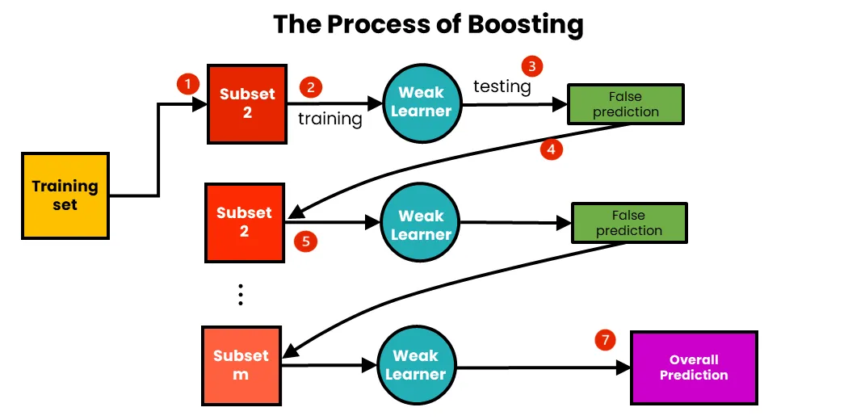
Boosting Algorithm
This is a well known learning and a supervised
machine learning strategy that combines the
predictions of multiple weak moles to generate
powerful ensemble model.
Below three are some of the algorithms explained
In this,
LG Boost Regressor
Ada Boost Regressor
XG Boost Regressor

Slide 2
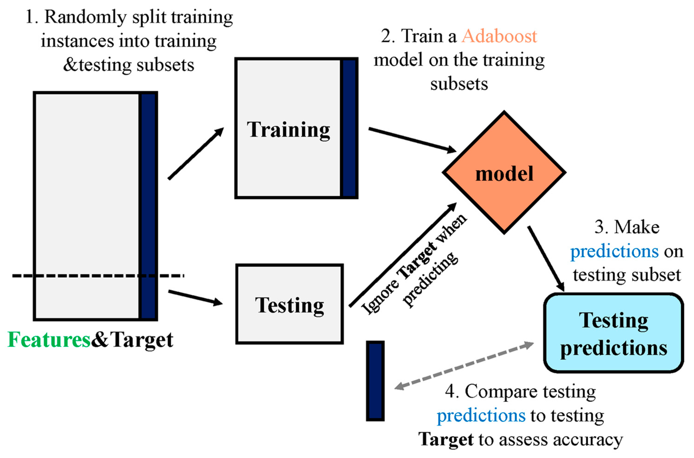
AdaBoost Algorithm:
This is also called Adaptive boosting which commonly
focuses on improving weak classifiers or learners
performance. It begins with a simple model, like a single
decision tree with one node and two leaves. This algorithm
Identifies and addresses mistakes made by this initial model
in predicting the data.
Applications
Image and face recognition
Financial Forecasting
Healthcare
Text analysis
Marketing and customer Relationship Management

Slide 3
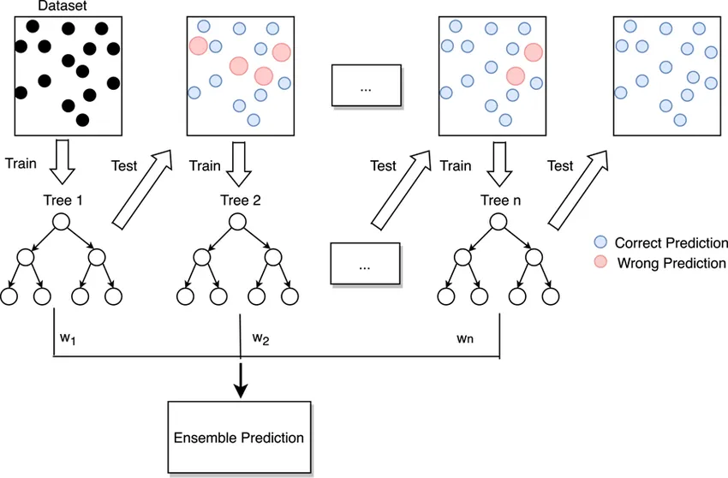
LG Boosting Algorithm
This is one of a type from Gradient boosting algorithm
and Lg boost algorithm combines several weak learners
into strong learners, in which each new model is trained
to minimise the loss function such as mean square
error of the previous model using gradient descent.

Slide 4
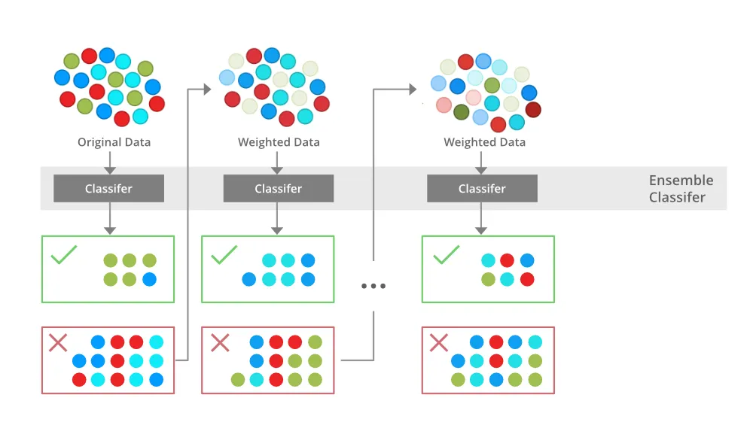
XG Boost Algorithm
This is also one of a type from Gradient boosting algorithm.
It offers a great deal of control to the users and it is designed
To be highly efficient , flexible and portable.
XG boost works by combining a number of weak learners to form
a strong learner. A weak learner is a machine learning model that
Is slightly better than random guessing. However, when weak
Learners ae combined, they form a strong learner.

Slide 5
R2_score for Boosting Algorithms
AdaBooster regression : 0.8447476929154872
LG boost regressor : 0.8833974199848822
XG boost regressor : 0.8713490621922348
Hence the LG boost provides a better r2_score.

